Slide 1
TRAFFIC VIOLATION DETECTION
TEAM MEMBERS: MENTOR:
1.NANDHAGOPAL B (20ITB29) DR . P. UMA MAHESHWARI
2.KALIDASS S (20ITB26)

Slide 2
INTRODUCTION::
The increasing number of vehicles in Metropolitan cities can cause traffic violations. These violation comprises of Reckless driving, crossing speed limit,signal jumping, hit and run, riding without helmet, Using phones while driving, parking violation and wrong direction violation and monitoring these actions becomes more critical and tedious. This causes severe destruction of property and more accidents that may endanger the lives of the people.

Slide 3
INTRODUCTION::
To overcome such unfathomable consequences and to provide proper solution for traffic violation, automatic traffic violation detection system can be implemented in hot spot of the Metropolitan cities. For which the system enforces proper traffic regulations at all times, and apprehend those who does not comply.

Slide 4
OBJECTIVE:
The goal of the project is to automate the traffic rules violation detection system and make it ease for the traffic police department to monitor the traffic and take action against the violated vehicle owner in a fast and efficient way. Detecting and tracking the vehicle and their activities accurately is the main priority of the system.

Slide 5
TIMELINE:

Slide 6
REQUIREMENTS: SOFTWARE REQUIREMENTS: 1.ANACONDA NAVIGATOR(JUPYTER NOTEBOOK) 2.CONVOLUTION NEURAL NETWORKS ALGORITHM 3.FLASK FRAMEWORK HARDWARE REQUIREMENTS: 1.COMPUTER SYSTEM: -RAM:8 GB -MEMORY:10 GB 2.NETWORK CONNECTION

Slide 7
Literature Survey:
S.No | Paper Name, Author, Year | Publication | Inference
1. | TRAFFIC SIGNAL VIOLATION DETECTION USING ARTIFICIAL INTELLIGENCE AND DEEP LEARNING. Dr. S. Raj Anand Professor, Dept of Computer Science and Engineering, Vemu Institute of Technology, Chittoor, India DOI:10.34218/IJARET.12.2.2021.019 | ©IAEME Publication Scopus Indexed | The number of new vehicles on the road is increasing rapidly, which in turn causes highly congested roads and serving as a reason to break traffic rules by violating them. This leads to a high number of road accidents. Traffic violation detection systems using computer vision are a very efficient tool to reduce traffic violations by tracking and Penalizing. The proposed system was implemented using YOLOV3 object detection for traffic violation detections such as signal jump, vehicle speed, and the number of vehicles
2. | REAL TIME VEHICLE DETECTION, TRACKING AND COUNTING USING RASPBERRY-PI. Apeksha P Kulkarni; Vishwanath P Baligar DOI: 10.1109/ICIMIA48430.2020.9074944 | IEEE | Population explosion leads to an unprecedented increase in the number of physical objects or vehicles on road. As a result, the number of road accidents increases due to a very heavy traffic flow. In this paper, traffic flow is monitored by using computer vision paradigm, where images or sequence of images provides a betterment on the road view. In order to detect vehicles, monitor and estimate traffic flow using low cost electronic devices, this research work utilizes camera module of raspberry pi along with Raspberry Pi 3. It also aims to develop a remote access using raspberry-pi to detect, track and count vehicles only when some variations occur in the monitored area. The proposed system captures video stream like vehicles in the monitored area to compute the information and transfer the compressed video stream for providing video based solution that is mainly implemented in Open CV by Python Programming

Slide 8
S.No | Paper Name, Author, Year | Publication | Inference
3. | AUTOMATED TRAFFIC VIOLATION APPREHENSION SYSTEM USING GENETIC ALGORITHM AND ARTIFICIAL NEURAL NETWORK. Aaron Christian P. Uy; Ana Riza F. Quiros; Rhen Anjerome Bedruz; Alexander Abad; Argel Bandala. DOI: 10.1109/TENCON.2016.7848395 | IEEE | Developing countries face the problem of crowded and congested roads because of inefficient implementation of traffic rules. Motorists ignore the rules because they are not apprehended and can get away easily. This paper proposes an intelligent traffic system that is able to automatically detect and apprehend traffic violators, specifically motorists who either swerve or block the pedestrian lane. The system is designed by integrating three processes: violation detection, plate localization and plate recognition. The violation detection and plate localization were realized using genetic algorithm while the plate recognition process was performed using an artificial neural network. The recognition of the plate number is highly dependent on the position of the detected vehicle with respect to the camera
4. | MOVING OBJECT DETECTION USING GENETIC ALGORITHM FOR TRAFFIC SURVEILLANCE PUBLJAYASHREE DEY; N PRAVEEN | IEEE | The objective of paper is to review the video segmentation and moving object detection methods, organize them into different categories. Object detection and tracking is a stimulating problem. The object identification can identify a moving object and discard unwanted candidate area which does not include an interesting object. The techniques used for the general video segmentation for traffic surveillance using genetic dynamic saliency map (GDSM) and background subtraction. Here combine Genetic Dynamic saliency map (GDSM) and Background subtraction is used for identifies moving object and the maximum distance moved by the object in given group of frames. Experimental results show that the traffic surveillance system can detect moving object

Slide 9
S.No | Paper Name, Author, Year | Publication | Inference
5. | MACHINE VISION FOR TRAFFIC VIOLATION DETECTION SYSTEM THROUGH GENETIC ALGORITHM. AARON CHRISTIAN P. UY; RHEN ANJEROME BEDRUZ; ANA RIZA QUIROS; ARGEL BANDALA; ELMER P. DADIOS DOI: 10.1109/HNICEM.2015.7393241 | IEEE | This paper presents a machine vision algorithm to detect traffic violations specifically swerving and blocking the pedestrian lane. The proposed solution consists of background difference method, and focuses on the genetic algorithm of the system to detect these violations. The general process is as follows: a capture picture is to be subtracted first by the reference image, then the genetic algorithm is run to find the violator, and finally a display is outputted with the corresponding type of violation.
6. | OPTIMIZATION OF VEHICLE CLASSIFICATION MODEL USING GENETIC ALGORITHM. CYRIL DALE L. CERO; EDWIN SYBINGCO; ALLYSA KATE M. BRILLANTES; MARI CHRISTINE E. AMON; JOHN CARLO V. PUNO. DOI: 10.1109/HNICEM48295.2019.9072880 | IEEE | This paper focuses on classifying vehicle types into car, van, motorcycle, bus, light truck, multi-axle truck and determine its class based on the Philippine Toll Regulatory Board's vehicle classification. This study utilized devolpe, an open-source tool that uses genetic algorithm for evolving number of filters and nodes, optimizer, activation, dropout rate. The model attained the best accuracy with 78.53% using 9000 images from MIO-TCD dataset

Slide 10
S.No | Paper Name, Author, Year | Publication | Inference
7. | AUTONOMOUS VEHICLE PUBLIC TRANSPORTATION SYSTEM. ALBERT Y. S. LAM; YIU-WING LEUNG; XIAOWEN CHU DOI: 10.1109/ICCVE.2014.7297613 | IEEE | Under active research, technology of autonomous vehicles (AVs) is getting mature and many AVs will run on the roads in the near future. With the support of vehicular ad-hoc network, AVs become connected. The ability of high degree of control allows AVs to respond to instantaneous situations cooperatively with high efficiency and flexibility. In this paper, we propose a new public transport offering point-to-point services with ride sharing. It manages a fleet of AVs to accommodate a number of transportation requests. Due to the unmanned nature, AVs operate by following the routes instructed by the control center of the system. With proper scheduling, the control center assigns the transportation requests to appropriate AVs in order to minimize the total operational cost. We formulate the scheduling problem with a mixed-integer program
8. | AUTOMATIC TRAFFIC VIOLATION RECORDING AND REPORTING SYSTEM TO LIMIT TRAFFIC ACCIDENTS : BASED ON VEHICULAR AD-HOC NETWORKS (VANET). SAMIR A. ELSAGHEER MOHAMED DOI:10.1109/ITCE.2019.8646449 | IEEE | The number of road accidents increases and causes many problems. Many people die and injured. In addition, that causes many economic, social and psychological problems that have negative impact to the development of the world. The main cause of the majority of these accidents is due to the violation of the traffic rules: driving with high speeds, crossing a red-light signal, not keeping sufficient distance with the front vehicle in the highways, driving in the wrong reverse direction, etc. As the number of roads and streets are very large and the total length of these roads is very long, there is no way to fully monitor all of them all the time by Traffic Patrol or camera systems.This paper proposes a system to automatically and autonomously detect and record the traffic violations without the help of the human being

Slide 11
S.No | Paper Name, Author, Year | Publication | Inference
9. | REAL TIME TRAFFIC SIGNAL VIOLATION USING ARTIFICIAL INTELLIGENCE AND MACHINE LEARNING. AJIT CHAURASIYA, ATUL KUMAR JHA, DIBYANSHU JHA. DOI:10.17577/IJERTCONV10IS12013 | IJERT | This Research focus on an automated Real-Time Traffic Signal Violation Detection using Artificial Intelligence and Machine learning the aim of the Project is to detect all the violation that takes place on a traffic signal .As we know in this new evolving world traffic violation is the major issue and is increasing day by day .so this project mainly focuses on how to tackle the evolving traffic problem where we use automated software which detects the violations The principal objective of this project is to control the traffic rule violations accurately and cost effectively
10. | A Robotic Model Approach of an Automated Traffic Violation Detection System with Apprehension. Rhen Anjerome Bedruz; Aaron Christian P. Uy; Ana Riza Quiros. DOI: 10.1109/HNICEM.2018.8666321. | IEEE | This study suggests a robotic model approach to create a sample traffic violation detection system with apprehension scenario before such system can be implemented in a real road. The model used two robots, one for the moving object which will be detected by the camera and one for the robot that will follow the moving object if its speed reaches a certain limit. The captured images from the camera were fed to an algorithm which detects the centroid of the moving object to track its speed, thereby deciding if it is moving beyond the reference speed. The result of this algorithm was fed to the tracker robot, which then mobilizes and follows the moving object when the moving object exceeds the speed limit.

Slide 12
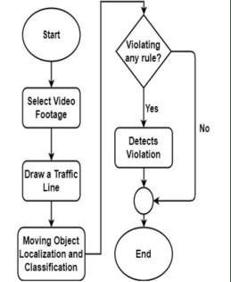
System ARCHITECTURE

Slide 13
Proposed Work
IMAGE PROCESSING:
Grayscaling and blurring : As the part of pre processing the input frame got from the CCTV footage, the image is grayscaled and blurred with Gaussian Blur method.
Background Subtraction : Background subtraction method is used to subtract the current frame from the reference frame to get the desired object’s area.
dst(I) = saturate(|scr1(I) − scr2(I)|)
Binary Threshold : Binarization method is used to remove all the holes and noises from the frame and get the desired object area accurately.
dst(x, y) = maxVal if scr(x, y) > thresh else 0
Dilation and find the contour :After getting the thresholded image, it is dilated to fill the holes and the contour is found from the image. drawing rectangle box over the contours desired moving objects are taken.

Slide 14
Proposed Work
VEHICLE CLASSIFICATION: From the given video footage, moving objects are detected. An object detection model YOLOv3 is used to classify those moving objects into respective classes. YOLOv3 is the third object detection algorithm in YOLO (You Only Look Once) family. It improved the accuracy with many tricks and is more capable of detecting objects. The classifier model is built with Darknet-53 architecture.
VIOLATION DETECTION: The vehicles are detected using YOLOv3 model. After detecting the vehicles, violation cases are checked. A traffic line is drawn over the road in the preview of the given video footage by the user. The line specifies that the traffic light is red. Violation happens if any vehicle crosses the traffic line in red state . The detected objects have a green bounding box. If any vehicle passes the traffic light in red state, violation happens. After detecting violation, the bounding box around the vehicle becomes red.

Slide 15
Implementation:
Computer Vision:
OpenCV is an open source computer vision and machine learning software library which is used in this project for image processing purpose. Tensorflow is used for implementing the vehicle classifier with darknet-53.
Graphical User Interface:
Tkinter library has been used to build the GUI. The graphical user interface has all the options needed for the software.

Slide 16
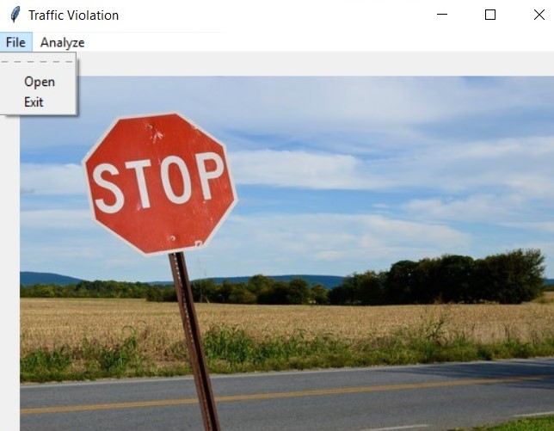
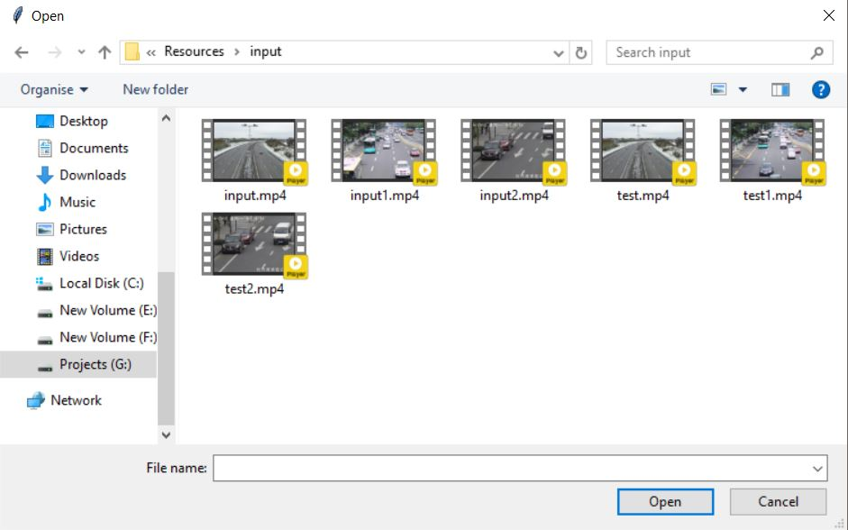
IMPLEMENTATION:
GUI
Opening a video footage from storage

Slide 17
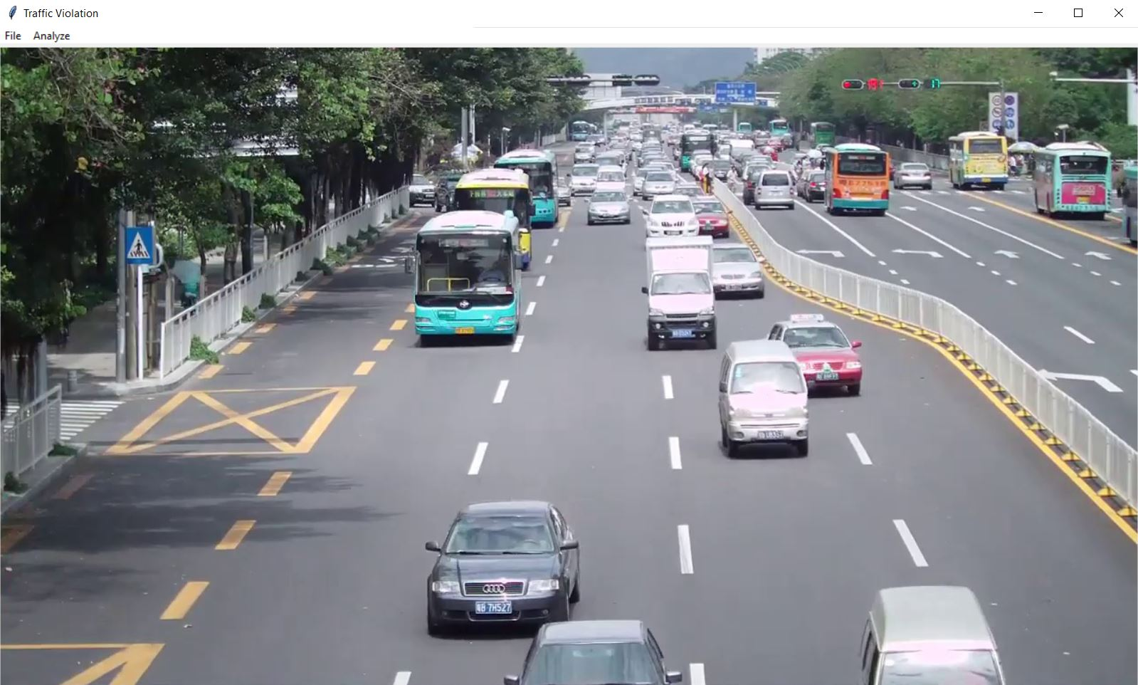
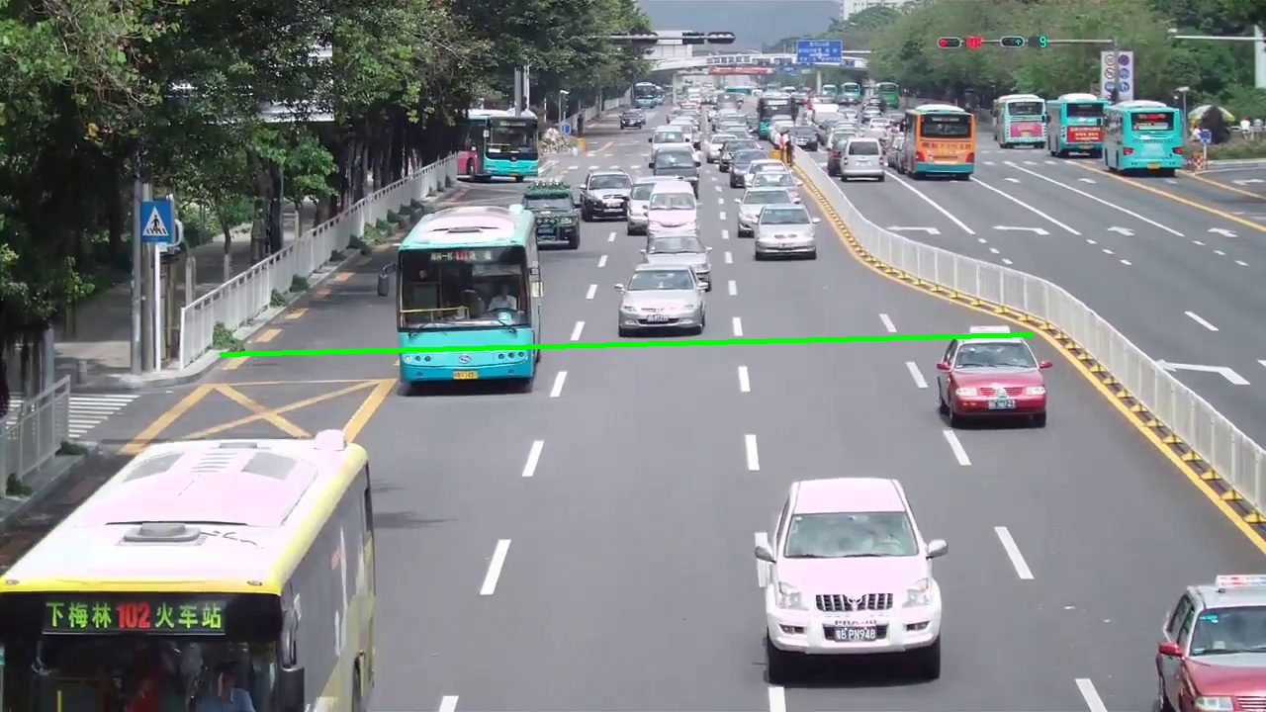
IMPLEMENTATION:
Preview Loaded for specific video footage
Region of Interest
(Drawing Signal Line)

Slide 18
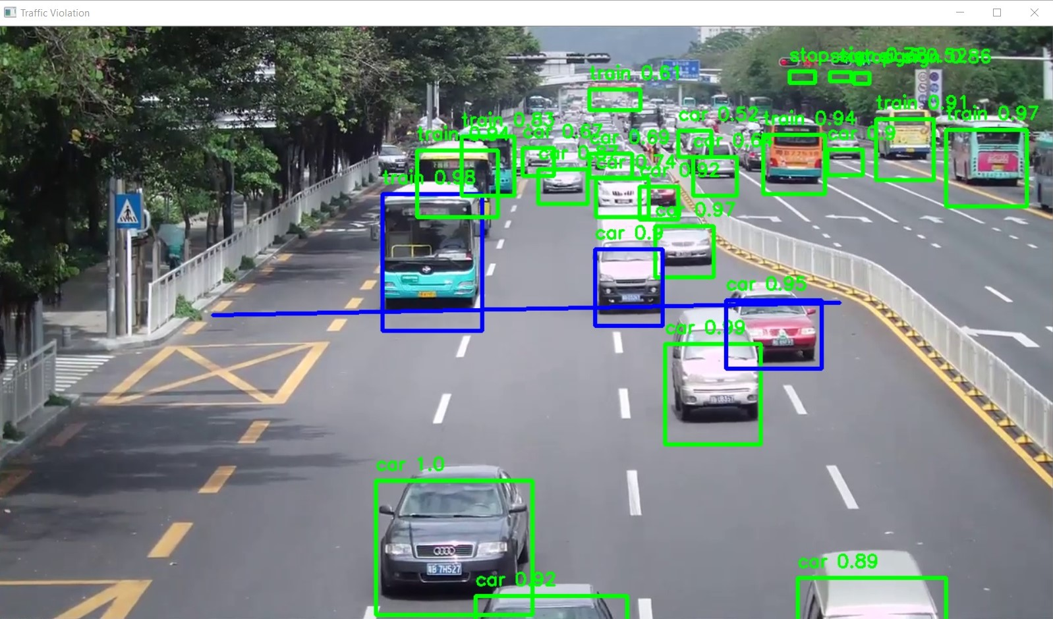
IMPLEMENTATION:
Final Output
(on each frame)

Slide 19
Existing system
The extraction based system for lane and traffic rule voiation detection and tracking using low cost Raspberry Pi hardware. The experimental work suggest that, Grab cut and Hough transform techniques performed better on test image dataset to identify vehicle lane on highways. Further, combination of RootSIFT with Flann-index matcher gives superior results (accuracy of 95.3%) as compared to other feature extraction and matchers on the given dataset for detection of traffic rule violation and tracking of vehicles

Slide 20
FUTURE PLAN:
Adding more real life features
Making this system more robust
Adding Number Plate Detection with OCR support
Adding more traffic violation conditions

Slide 21
THANK YOU

